Slide 1
What We Did So Far
December 2018

Slide 2
Table of Contents
Monitoring Schemes
Monitored Functions

Slide 3
Monitoring Schemes

Slide 4
Monitoring Schemes
Vector Scheme
Value Scheme
Distance Scheme
Sketched Data Resolution
Sketched Change Resolution

Slide 5
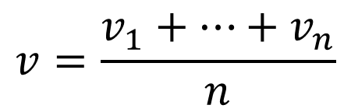

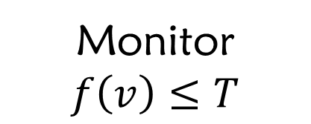
Reminder: Monitoring Objective
$$node_{i}←v_{i}$$
Convex f
$$v=\frac{v_{1}+…+v_{n}}{n}$$
Monitor
$$f\left(v\right)≤T$$

Slide 6
Vector Scheme

Slide 7
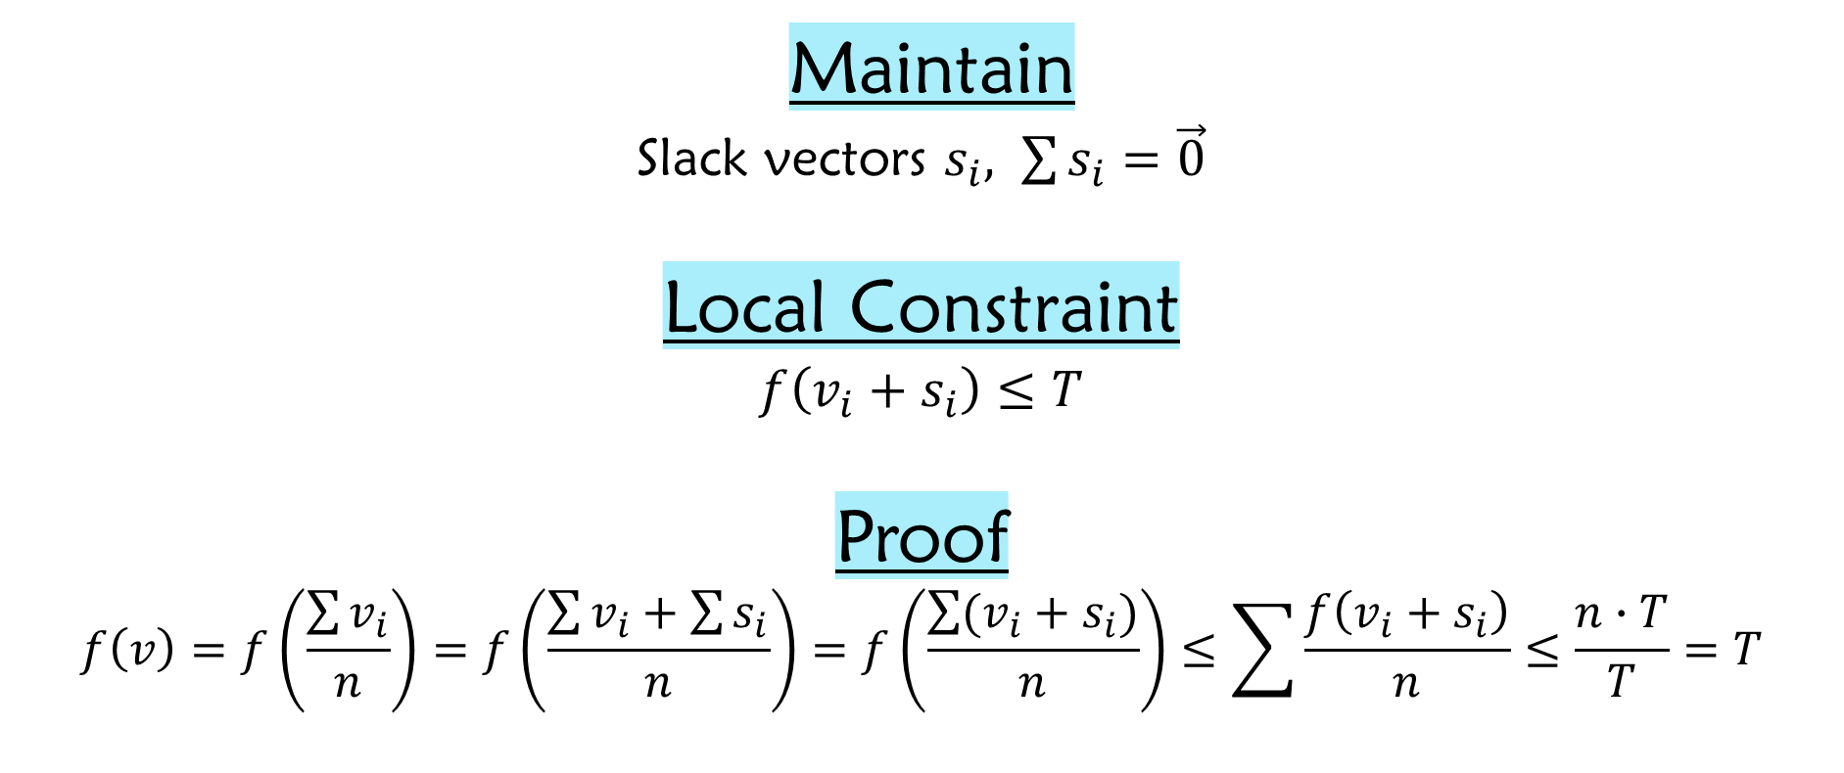
Vector Scheme
Maintain
Slack vectors $s_{i}, \sum{s_{i}}=\vec{0}$
Local Constraint
$$f\left(v_{i}+s_{i}\right)≤T$$
Proof
$$f\left(v\right)=f\left(\frac{\sum{v_{i}}}{n}\right)=f\left(\frac{\sum{v_{i}}+\sum{s_{i}}}{n}\right)=f\left(\frac{\sum{(v_{i}+s_{i})}}{n}\right)≤\sum{\frac{f\left(v_{i}+s_{i}\right)}{n}}≤\frac{n∙T}{T}=T$$

Slide 8
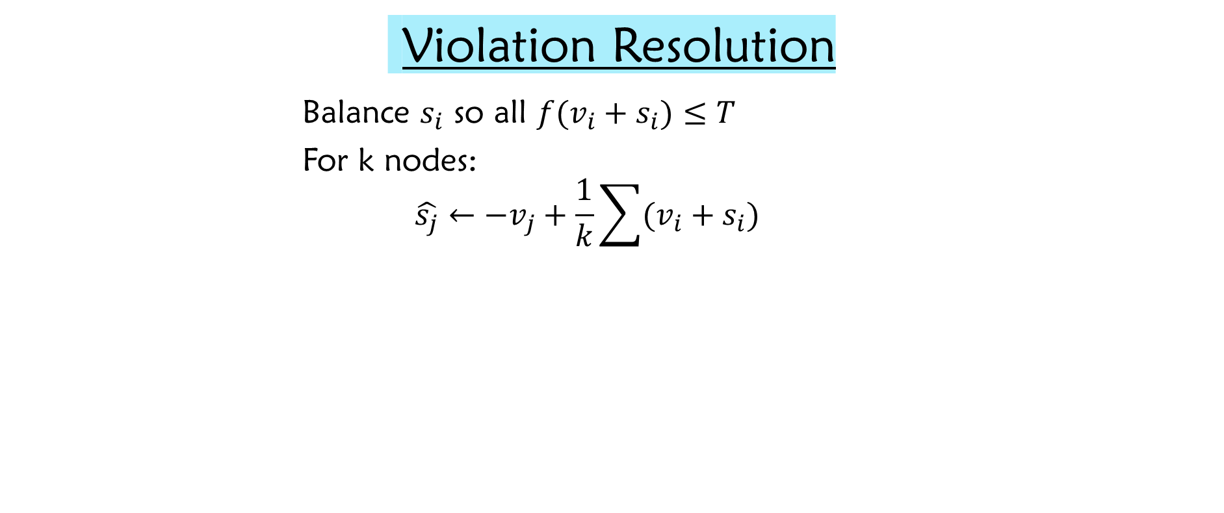
Vector Scheme
Violation Resolution
Balance $s_{i}$ so all $f(v_{i}+s_{i})≤T$
For k nodes:
$$\hat{s_{j}}←−v_{j}+\frac{1}{k}\sum{(v_{i}+s_{i})}$$

Slide 9
Distance Scheme

Slide 10
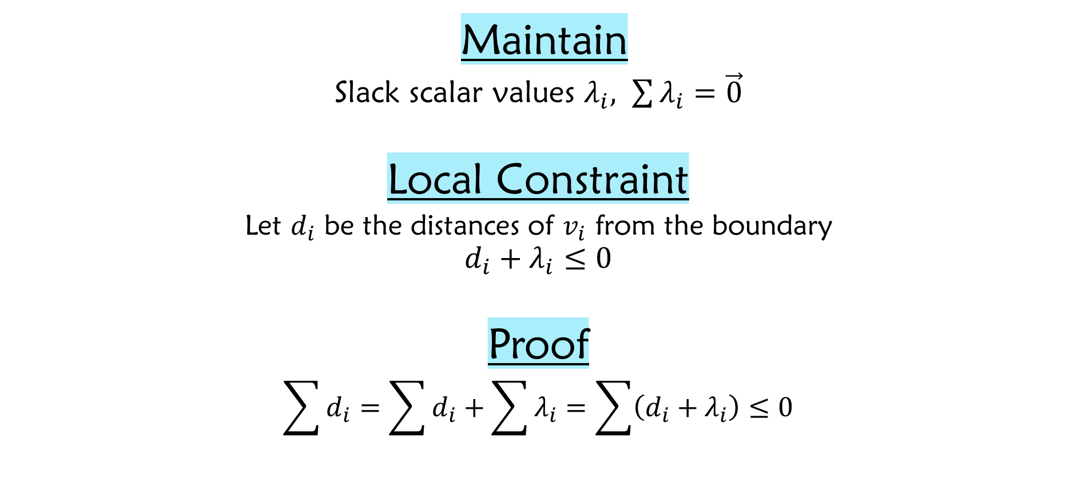
Distance Scheme
Maintain
Slack scalar values $λ_{i}, \sum{λ_{i}}=\vec{0}$
Local Constraint
$$\text{Let} d_{i} \text{be} \text{the} \text{distances} \text{of} v_{i} \text{from} \text{the} \text{boundary}$$
$$d_{i}+λ_{i}≤0$$
Proof
$$\sum{d_{i}}=\sum{d_{i}}+\sum{λ_{i}}=\sum{\left(d_{i}+λ_{i}\right)≤0}$$
Distance Lemma

Slide 11

Distance Scheme
Violation Resolution
Balance $λ_{i}$ so all $d_{i}+λ_{i}≤0$
For k nodes:
$$\hat{λ_{j}}←−d_{j}+\frac{1}{k}\sum{(d_{i}+λ_{i})}$$

Slide 12
Value Scheme

Slide 13
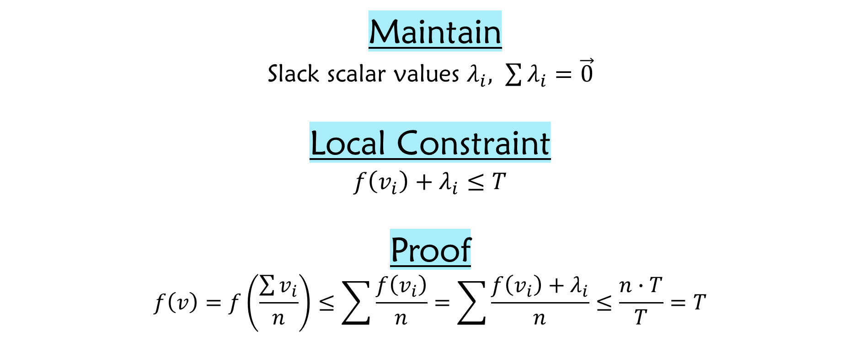
Value Scheme
Maintain
Slack scalar values $λ_{i}, \sum{λ_{i}}=\vec{0}$
Local Constraint
$$f\left(v_{i}\right)+λ_{i}≤T$$
Proof
$$f\left(v\right)=f\left(\frac{\sum{v_{i}}}{n}\right)≤\sum{\frac{f\left(v_{i}\right)}{n}}=\sum{\frac{f\left(v_{i}\right)+λ_{i}}{n}}≤\frac{n∙T}{T}=T$$

Slide 14

Value Scheme
Violation Resolution
Balance $λ_{i}$ so all $f\left(v_{i}\right)+λ_{i}≤T$
For k nodes:
$$\hat{λ_{j}}←−f\left(v_{j}\right)+\frac{1}{k}\sum{(f\left(v_{i}\right)+λ_{i})}$$

Slide 15
Sketched Data Resolution

Slide 16





Gradual Full Sync
Value Scheme
Fail
Success
$||$Sketch$||$ = 2
Fail
Success
$||$Sketch$||$ = 4
$$⋮$$
$$⋮$$
$||$Sketch$||$ = ^{n}/₂

Slide 17
Gradual Full Sync
Distance Scheme
Fail
Success
$||$Sketch$||$ = 2
Fail
Success
$||$Sketch$||$ = 4
$$⋮$$
$$⋮$$
$||$Sketch$||$ = ^{n}/₂

Slide 18
Some Intuition
Vector Scheme’s Resolution
‘Sketched’ Resolution

Slide 19
Some Intuition
Vector Scheme’s Resolution
‘Sketched’ Resolution

Slide 20
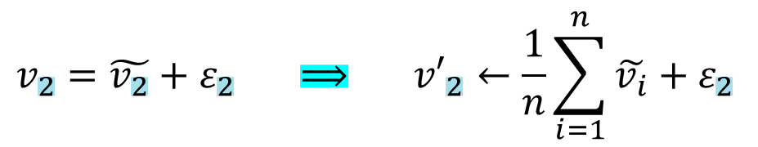

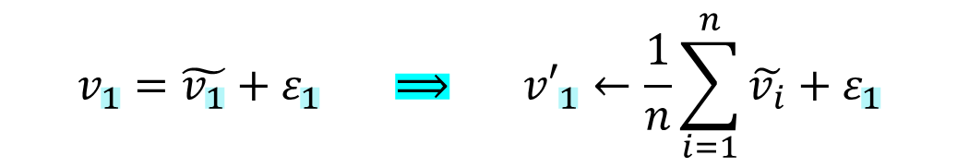





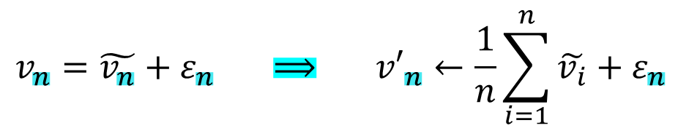
Sketched Data Resolution
Violation Resolution
$$v_{1}=\tilde{v_{1}}+ε_{1} ⟹ {v′}_{1}←\frac{1}{n}\sum_{i=1}^{n}{\tilde{v_{i}}}+ε_{1}$$
$$v_{2}=\tilde{v_{2}}+ε_{2} ⟹ {v′}_{2}←\frac{1}{n}\sum_{i=1}^{n}{\tilde{v_{i}}}+ε_{2}$$
Coordinator
$$\frac{1}{n}\sum_{i=1}^{n}{\tilde{v_{i}}}$$
$$\frac{1}{n}\sum_{i=1}^{n}{\tilde{v_{i}}}$$
$$⋮$$
$$v_{n}=\tilde{v_{n}}+ε_{n} ⟹ {v′}_{n}←\frac{1}{n}\sum_{i=1}^{n}{\tilde{v_{i}}}+ε_{n}$$
$$\tilde{v_{1}}$$
$$\tilde{v_{2}}$$
$$\tilde{v_{n}}$$
…

Slide 21
Sketched Change Resolution

Slide 22






Sketched Change Resolution
Violation Resolution
Recall, $v_{i}=ref+chng$
Perform sketch function on $chng$ vector
Instead of on $v_{i}$
Coordinator
$$\frac{1}{n}\sum_{i=1}^{n}{\tilde{{chng}_{i}}}$$
$$\frac{1}{n}\sum_{i=1}^{n}{\tilde{{chng}_{i}}}$$
$$\tilde{{chng}_{1}}$$
$$\tilde{{chng}_{2}}$$
$$\tilde{{chng}_{n}}$$
…

Slide 23
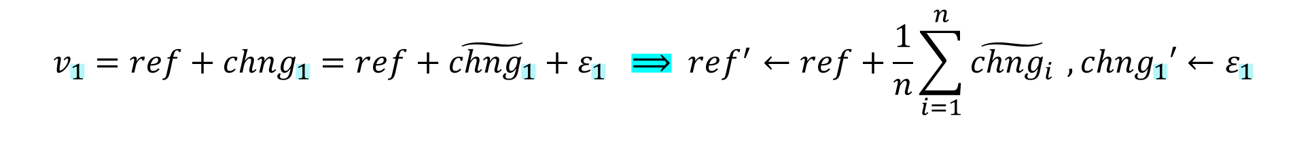

Sketched Change Resolution
Violation Resolution
$$v_{1}=ref+{chng}_{1}=ref+\tilde{{chng}_{1}}+ε_{1} ⟹ ref^{′}←ref+\frac{1}{n}\sum_{i=1}^{n}{\tilde{{chng}_{i}}} ,{chng}_{1}′←ε_{1}$$
$$v_{2}=ref+{chng}_{2}=ref+\tilde{{chng}_{2}}+ε_{2} ⟹ ref^{′}←ref+\frac{1}{n}\sum_{i=1}^{n}{\tilde{{chng}_{i}}} ,{chng}_{2}′←ε_{2}$$
$$⋮$$
$$v_{n}=ref+{chng}_{n}=ref+\tilde{{chng}_{n}}+ε_{n} ⟹ ref^{′}←ref+\frac{1}{n}\sum_{i=1}^{n}{\tilde{{chng}_{i}}} ,{chng}_{n}′←ε_{n}$$

Slide 24
Monitored Functions

Slide 25
Monitored Functions
Inner Product
Entropy
Norm Squared
Spectral Gap
AMS F₂

Slide 26
Inner Product

Slide 27
Inner Product
f(x,y)=<x,y>=¹/₄($||$x+y$||$² - $||$x-y$||$²)
 | Bounding Convex Function | Distance to Convex Function
Upper Bound | Mathematical Solution | Mathematical Solution
Lower Bound | Mathematical Solution | Mathematical Solution

Slide 28
Entropy

Slide 29
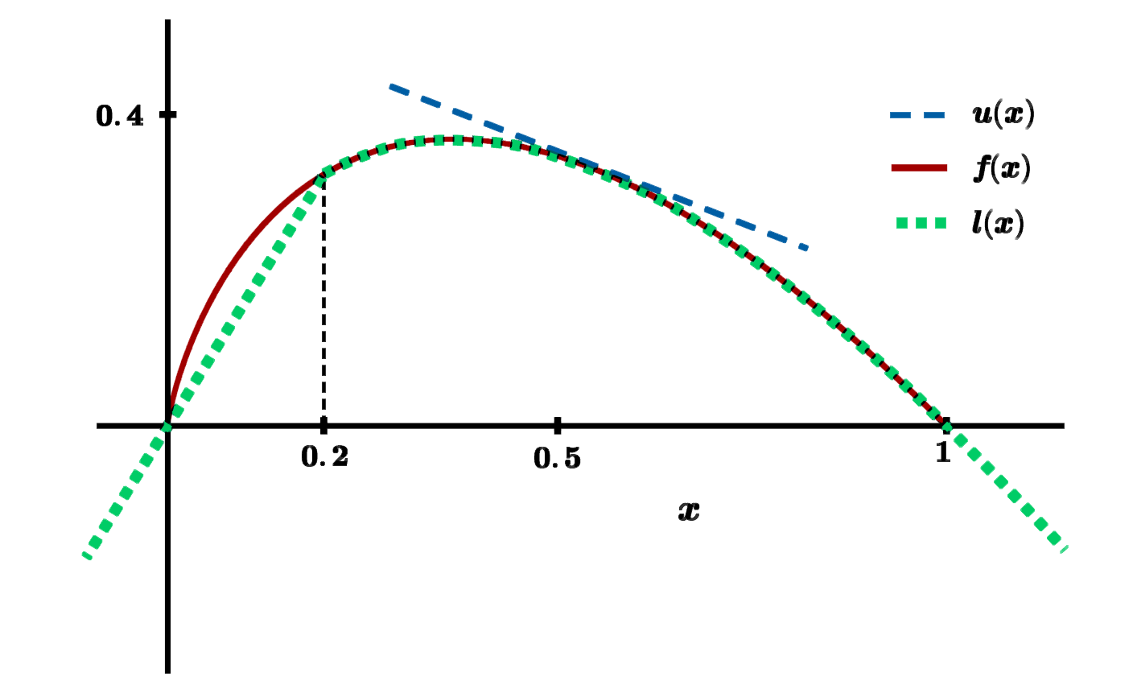
Entropy
f(x)=-$Σ$(x_{i}$∙$ln(x_{i}))

Slide 30
Entropy
f(x)=-$Σ$(x_{i}$∙$ln(x_{i}))
 | Bounding Convex Function | Distance L₁ to Convex Function
Upper Bound | Tangent Plane | Mathematical Solution
Lower Bound | Function Itself | Computational Method

Slide 31
Norm Squared

Slide 32
Norm Squared
f(x)= $||$x$||$²
 | Bounding Convex Function | Distance to Convex Function
Upper Bound | Tangent Plane | Mathematical Solution
Lower Bound | Function Itself | Mathematical Solution

Slide 33
Spectral Gap

Slide 34
Spectral Gap
f(M)= $λ$₁(M)-$λ$₂(M)
 | Bounding Convex Function | Distance to Convex Function
Upper Bound
Lower Bound | Mathematical Solution | Bound of Distance

Slide 35
AMS F₂

Slide 36
AMS F₂
f(M)= median of row averages of M$∙$M (pointwise mul)
 | Bounding Convex Function | Distance to Convex Function
Upper Bound | Mathematical Solution | Mathematical Solution
Lower Bound

Slide 37
Experimental Results

Slide 38
Inner Product

Slide 39
Bag-of-Words Textual Data Sources
Tweets from the end of 2009
Blogs textual data
Restaurant Reviews
Reddit comments from 2015
Spam click-baits new headlines
News pieces from India
Wikipedia article as of March 2017
Amazon reviews of movies
X
<X,Y>
Y

Slide 40
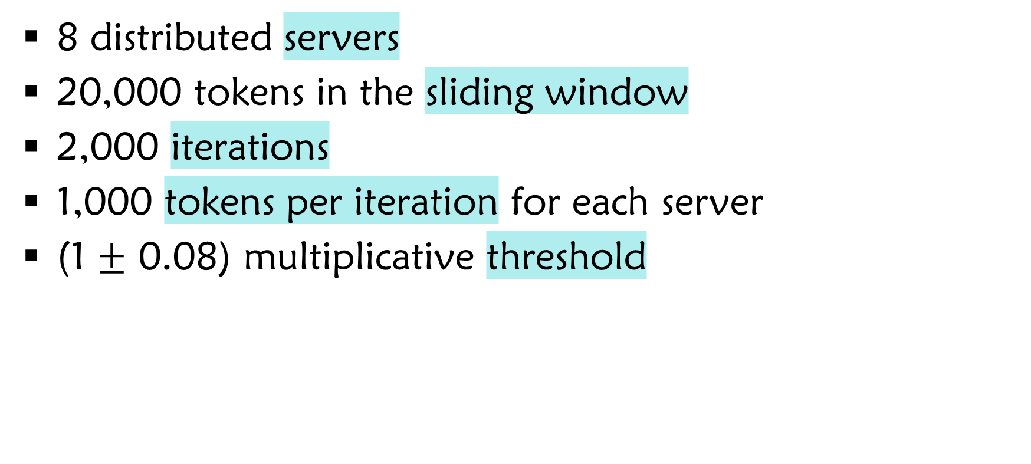
Parameters
8 distributed servers
20,000 tokens in the sliding window
2,000 iterations
1,000 tokens per iteration for each server
(1 $±$ 0.08) multiplicative threshold

Slide 41
Bandwidth / iteration |vector|=5,000
Bandwidth
Iteration

Slide 42
Bandwidth / iteration |vector|=5,000
Bandwidth
Iteration

Slide 43
Bandwidth / |vector|
Bandwidth
|vector|

Slide 44
Bandwidth / |vector|
Bandwidth
|vector|

Slide 45
Average Amount of Full Syncs Compared to Oracle
Full Syncs
Scheme

Slide 46
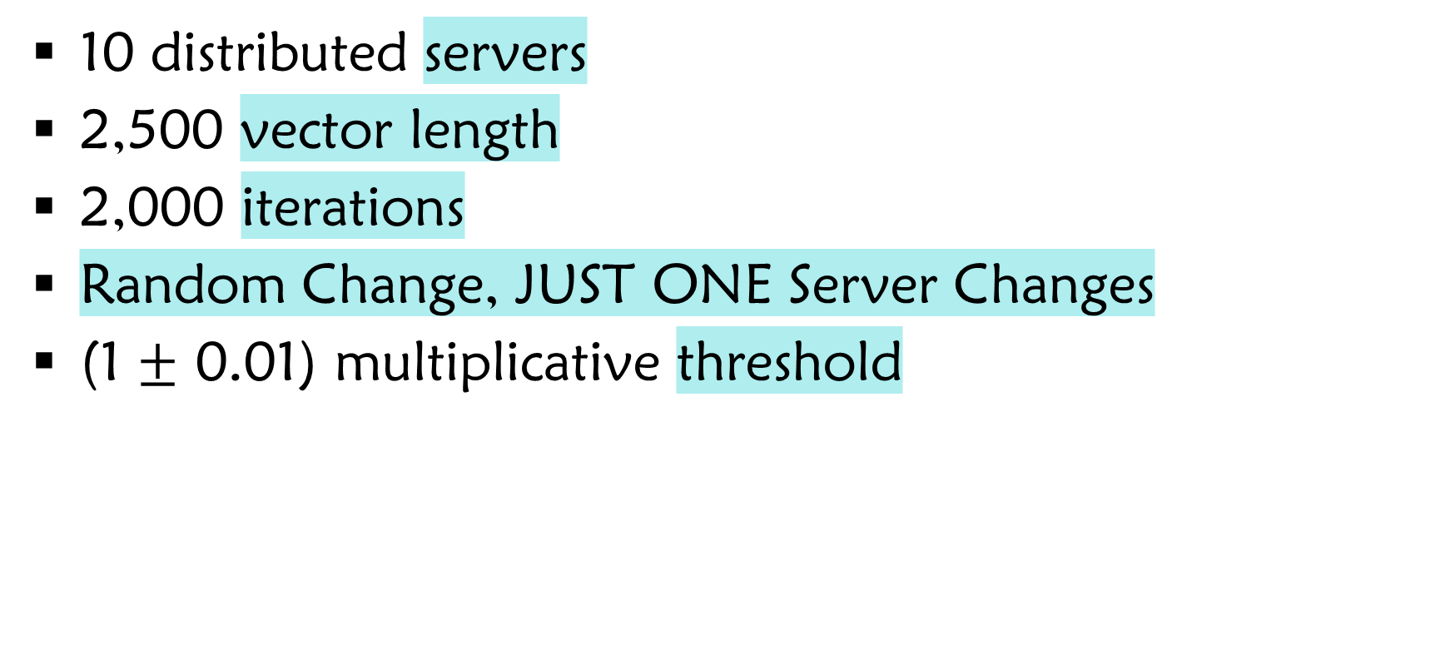
Parameters
10 distributed servers
2,500 vector length
2,000 iterations
Random Change, JUST ONE Server Changes
(1 $±$ 0.01) multiplicative threshold

Slide 47
Bandwidth / iteration
Bandwidth
Iteration

Slide 48
Bandwidth / iteration
Bandwidth
Iteration

Slide 49
Entropy

Slide 50
Bag-of-Words Textual Data Sources
Tweets from the end of 2009
Blogs textual data
Restaurant Reviews
Reddit comments from 2015
Spam click-baits new headlines
News pieces from India
Wikipedia article as of March 2017
Amazon reviews of movies

Slide 51
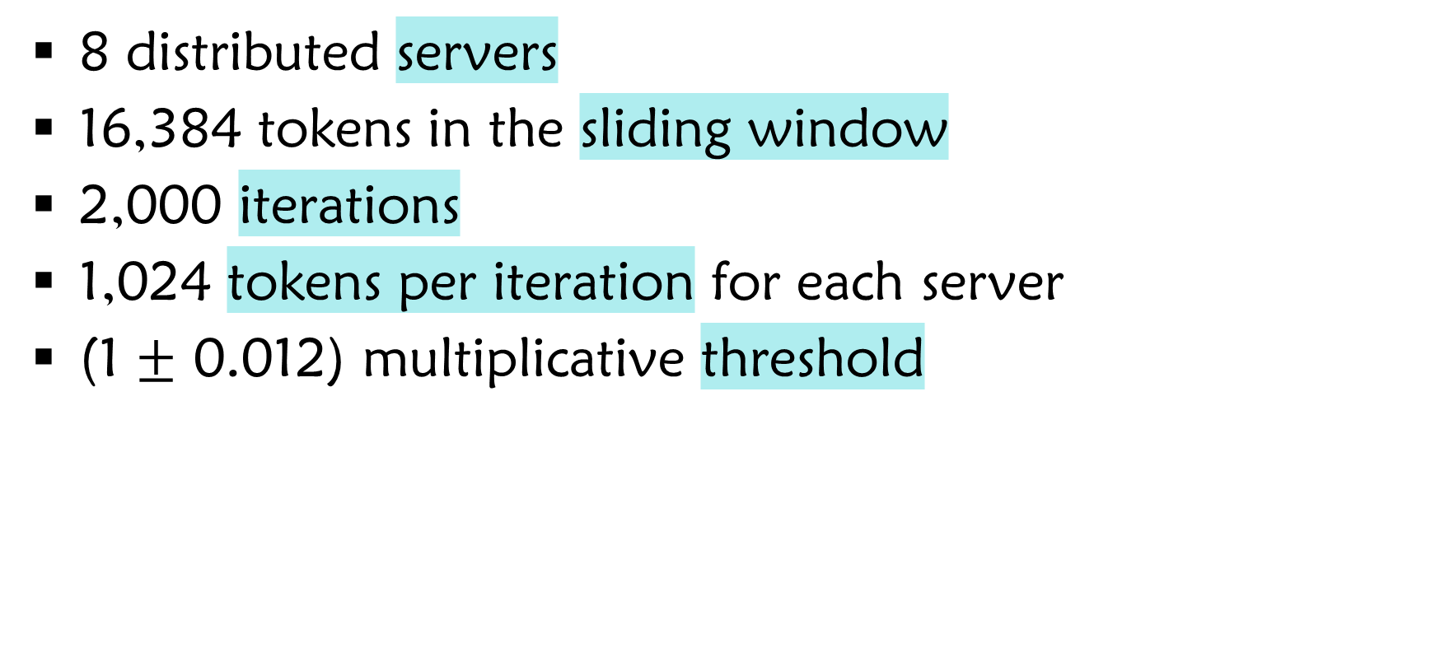
Parameters
8 distributed servers
16,384 tokens in the sliding window
2,000 iterations
1,024 tokens per iteration for each server
(1 $±$ 0.012) multiplicative threshold

Slide 52
Bandwidth / |vector|
Bandwidth
|vector|

Slide 53
Bandwidth / |vector|
Bandwidth
|vector|

Slide 54
Average Amount of Full Syncs Compared to Oracle
Full Syncs
Scheme

Slide 55
Spectral Gap

Slide 56

Parameters
G(100,0.2), edges are deleted
Constant threshold, T=5
Adjacency Matrix of 100x100 $→$ 4950 vector length

Slide 57
Bandwidth Per Iteration / # Nodes
Bandwidth Per Iteration
# Nodes

Slide 58
Full Syncs Per Iteration / # Nodes
# Full Syncs Per Iteration
# Nodes

Slide 59
AMS F₂

Slide 60
Parameters
10 distributed servers
Synthetic randomized data
Constant threshold

Slide 61
Bandwidth / iteration 52x47 F₂ Sketch
Bandwidth
Iteration

Slide 62
Bandwidth / |vector|
Bandwidth
|vector|

Slide 63
Bandwidth / |vector|
Bandwidth
|vector|

Slide 64
Average Full Syncs
Bandwidth
Scheme

